Slide 1
Transaction Processing System and Management Information System

Slide 2
Transaction Processing System
TPSs collect, store, modify, and retrieve the transactions of an organization.
A transaction is an event that generates or modifies data that is eventually stored in an information system.

Slide 3
Objectives of TPS
Process data generated by and about transactions
Ensure data and information integrity and accuracy
Produce timely documents and reports
Increase labor efficiency
Help provide increased and enhanced service
Help build and maintain customer loyalty
Achieve competitive advantage

Slide 4
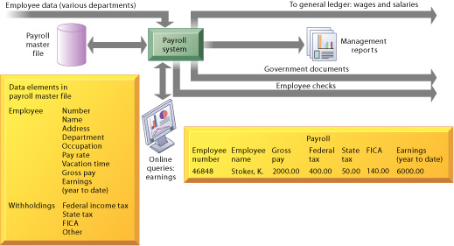
A Symbolic Representation for a Payroll TPS

Slide 5
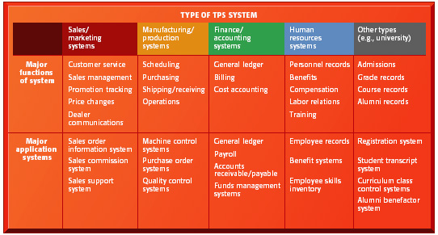
Typical Applications of TPS

Slide 6
Transaction Processing System
To be considered a transaction processing system the computer must pass the ACID test.
Atomicity: requires that each transaction is "all or nothing”
Consistency: Ensures that any transaction will bring the database from one valid state to another.
Isolation : Ensures that the concurrent execution of transactions results in a system state that would be obtained if transactions were executed serially.
Durability: means that once a transaction has been committed, it will remain so.

Slide 7
Batch vs. On-Line Transaction Processing
Two types of TPS:
Batch processing
A system whereby business transactions are accumulated over a period of time and prepared for processing as a single unit or batch
On-line transaction processing (OLTP)
A system whereby each transaction is processed immediately, without the delay of accumulating transactions into a batch

Slide 8
Data Processing Activities Common to TPSs
A transaction processing cycle
Data collection
Data editing
Data correction
Data manipulation
Data storage
Document production

Slide 9
Transaction Processing System
Rapid Response
Fast performance with a rapid response time is critical. Businesses cannot afford to have customers waiting for a TPS to respond, the turnaround time from the input of the transaction to the production for the output must be a few seconds or less.

Slide 10
Transaction Processing System
Reliability
Many organizations rely heavily on their TPS; a breakdown will disrupt operations or even stop the business. For a TPS to be effective its failure rate must be very low. If a TPS does fail, then quick and accurate recovery must be possible. This makes well–designed backup and recovery procedures essential.

Slide 11
Transaction Processing System
Inflexibility
A TPS wants every transaction to be processed in the same way regardless of the user, the customer or the time for day. If a TPS were flexible, there would be too many opportunities for non-standard operations, for example, a commercial airline needs to consistently accept airline reservations from a range of travel agents, accepting different transactions data from different travel agents would be a problem.

Slide 12
Management Information Systems (MIS)
Management information system (MIS)
An MIS provides managers with information and support for effective decision making, and provides feedback on daily operations
Output, or reports, are usually generated through accumulation of transaction processing data
Each MIS is an integrated collection of subsystems, which are typically organized along functional lines within an organization

Slide 13
Outputs of a Management Information System
Scheduled reports
Produced periodically, or on a schedule (daily, weekly, monthly)
Key-indicator report
Summarizes the previous day’s critical activities
Typically available at the beginning of each day
Demand report
Gives certain information at a manager’s request
Exception report
Automatically produced when a situation is unusual or requires management action

Slide 14
Scheduled Report Example
Daily Sales Detail Report Prepared: 08/10/xx
Order # | Customer ID | Sales Rep ID | Ship Date | Quantity | Item # | Amount
P12453 | C89321 | CAR | 08/12/96 | 144 | P1234 | $3,214
P12453 | C89321 | CAR | 08/12/96 | 288 | P3214 | $5,660
P12453 | C03214 | GWA | 08/13/96 | 12 | P4902 | $1,224
P12455 | C52313 | SAK | 08/12/96 | 24 | P4012 | $2,448
P12456 | C34123 | JMW | 08J/13/96 | 144 | P3214 | $720

Slide 15
Key Indicator Report Example
Daily Sales Key Indicator Report
 | This Month | Last Month | Last Year
Total Orders Month to Date | $1,808 | $1,694 | $1,014
Forecasted Sales for the Month | $2,406 | $2,224 | $2,608

Slide 16
Demand Report Example
Daily Sales by Sales Rep Summary Report Prepared: 08/10/xx
Sales Rep ID | Amount
CAR | $42,345
GWA | $38,950
SAK | $22,100
JWN | $12,350

Slide 17
Exception Report Example
Daily Sales Exception Report – ORDERS OVER $10,000 Prepared: 08/10/xx
Order # | Customer ID | Sales Rep ID | Ship Date | Quantity | Item # | Amount
P12453 | C89321 | CAR | 08/12/96 | 144 | P1234 | $13,214
P12453 | C89321 | CAR | 08/12/96 | 288 | P3214 | $15,660
P12453 | C03214 | GWA | 08/13/96 | 12 | P4902 | $11,224
… | … | … | … | … | … | …
… | … | … | … | … | … | …

Slide 18
Characteristics of a Management Information System
Provides reports with fixed and standard formats
Hard-copy and soft-copy reports
Uses internal data stored in the computer system
End users can develop custom reports
Requires formal requests from users

Slide 19
Management Information Systems for Competitive Advantage
Provides support to managers as they work to achieve corporate goals
Enables managers to compare results to established company goals and identify problem areas and opportunities for improvement

Slide 20
Functional Aspects
MIS is an integrated collection of functional information systems, each supporting particular functional areas.

Slide 21
Internet
An Organization’s MIS
Financial MIS
Business transactions
Databases of valid transactions
Drill down reports
Accounting MIS
Transaction processing systems
Exception reports
Demand reports
Marketing MIS
Key-indicator reports
Scheduled reports
Business transactions
Databases of external data
Human Resources MIS
Etc.
Extranet
Etc.

Slide 22
Financial MIS
Provides financial information to all financial managers within an organization.

Slide 23
Databases of internal data
Databases of external data
Financial DSS
Business transactions
Databases of valid transactions for each TPS
Financial applications databases
Transaction processing systems
Financial MIS
Business transactions
Operational databases
Financial statements
Financial ES
Internet or Extranet
Uses and management of funds
Financial statistics for control
Business transactions
Customers, Suppliers

Slide 24
Inputs to the Financial Information System
Strategic plan or corporate policies
Contains major financial objectives and often projects financial needs.
Transaction processing system (TPS)
Important financial information collected from almost every TPS - payroll, inventory control, order processing, accounts payable, accounts receivable, general ledger.
External sources
Annual reports and financial statements of competitors and general news items.

Slide 25
Financial MIS Subsystems and Outputs
Financial subsystems
Profit/loss and cost systems
Auditing
Internal auditing
External auditing
Uses and management of funds

Slide 26
Financial MIS Subsystems and Outputs
Financial subsystems
Profit/loss and cost systems
Auditing
Internal auditing
External auditing
Uses and management of funds

Slide 27
Manufacturing MIS
A management information system designed specifically for use in a production environment

Slide 28
Databases of internal data
Databases of external data
Manufacturing DSS
Business transactions
Databases of valid transactions for each TPS
Manufacturing applications databases
Transaction processing systems
Manufacturing MIS
Business transactions
Operational
databases
Quality control reports
Process control reports
Manufacturing ES
Internet or Extranet
JIT reports
MRP reports
Production schedule
CAD output
Business transactions
Customers, Suppliers

Slide 29
Inputs to the Manufacturing MIS
Strategic plan or corporate policies.
The TPS:
Order processing
Inventory data
Receiving and inspecting data
Personnel data
Production process
External sources

Slide 30
Manufacturing MIS Subsystems and Outputs
Design and engineering
Master production scheduling
Inventory control
Manufacturing resource planning
Just-in-time inventory and manufacturing
Process control
Computer-integrated manufacturing (CIM)
Quality control and testing

Slide 31
Marketing MIS
Supports managerial activities in product development, distribution, pricing decisions, and promotional effectiveness

Slide 32
Databases of internal data
Databases of external data
Manufacturing DSS
Databases of valid transactions for each TPS
Marketing applications databases
Transaction processing systems
Marketing MIS
Business transactions
Sales by customer
Operational
databases
Sales by salesperson
Manufacturing ES
Sales by product
Pricing report
Total service calls
Customer satisfaction

Slide 33
Inputs to Marketing MIS
Strategic plan and corporate policies
The TPS
External sources:
The competition
The market

Slide 34
Marketing MIS Subsystems and Outputs
Marketing research
Product development
Promotion and advertising
Product pricing

Slide 35
Human Resource MIS
Concerned with all of the activities related to employees and potential employees of the organization

Slide 36
Databases of internal data
Databases of external data
Manufacturing DSS
Databases of valid transactions for each TPS
Human resource applications databases
Transaction processing systems
Human Resource MIS
Business transactions
Benefit reports
Operational
databases
Salary surveys
Manufacturing ES
Scheduling reports
Training test scores
Job applicant profiles
Needs and planning reports

Slide 37
Inputs to the Human Resource MIS
Strategic plan or corporate policies
The TPS:
Payroll data
Order processing data
Personnel data
External sources

Slide 38
Human Resource MIS Subsystems and Outputs
Human resource planning
Personnel selection and recruiting
Training and skills inventory
Scheduling and job placement
Wage and salary administration

Slide 39
Other MISs
Accounting MISs
Provides aggregated information on accounts payable, accounts receivable, payroll, and other applications.

